Slide 1
Software Quality Activities and Techniques
Part 1
Software Quality Engineering
CT051-3-3
Software Engineering
Prepared by: xxx First Prepared on: xx-xx-xx Last Modified on: xx-xx-xx
Quality checked by: xxx
Copyright 2004 Asia Pacific Institute of Information Technology

Slide 2
Learning Outcomes
To introduce the quality management process and key quality management activities

Slide 3
Topics covered
Process and product quality
Quality assurance and standards

Slide 4
Software Quality Management
Purpose
  Is to develop and manage the quality in software products
Concerned
  To ensure that the required level of quality is achieved in a software product
Involves
  Defining appropriate quality standards and procedures ensuring that these are followed
Ultimate objective
  Is to develop a ‘quality culture’ where quality is seen as everyone’s responsibility

Slide 5
Scope of quality management
Quality management is particularly important for large, complex systems. The quality documentation is a record of progress and supports continuity of development as the development team changes.
For smaller systems, quality management needs less documentation and should focus on establishing a quality culture.

Slide 6
The quality compromise
We cannot wait for specifications to improve before paying attention to quality management.
We must put quality management procedures into place to improve quality despite imperfect specifications.

Slide 7
Software Quality Management
Based on the following principles :
  Quality Principles
    It prescribe the operational excellence of software as well as its reliability to meet the changing requirements of customers and the technological advances
  Management Principles
    Are the activities of identifying standards, preparing guidelines, and processes to be used during the software development to ensure product meets the customers intention
  Engineering Principles
    Explain the rules and concepts that must be followed during software development lifecycle to solve technical issues.
    (following slides describes some of the principles)

Slide 8
Software Quality Management
Quality Principles
  Prevent defects from being introduced
  Defects that get in are detected and corrected as early as possible
  Establish and eliminate the causes as well as the symptoms of defects
  Independently audit work for compliance with standards and procedures

Slide 9
Software Quality Management
Management Principles
  Define roles and responsibilities
  Plan the work
  Track progress against the plans and take corrective action where necessary
  Progressively refine the plans

Slide 10
Software Quality Management
Engineering Principles
  Analyze the problem then develop the solution
  Break complex problems into several less complex ones
  Ensure the problems knit together by controlling their relationships
  Use recognized tools and techniques.

Slide 11
Quality management activities
Quality assurance
  Establish organisational procedures and standards for quality.
Quality planning
  Select applicable procedures and standards for a particular project and modify these as required.
Quality control
  Ensure that procedures and standards are followed by the software development team.

Slide 12
Quality management activities
Quality Assurance
Identify client’s quality expectations. The activities involve are;
  Defining and Implementing Processes
  Establishing clear processes and standards for development
  Verification and Validation processes
  Quality Audits
    Internal and external review of a software program to check its quality, progress or adherence to plans, standards and regulations
  Training and Development
    New tools
    V&V

Slide 13
Quality management activities
Quality Planning
It is the blueprint for accomplishing the intended software quality. The activities involve are;
  Preparing specific quality goals
    (e.g., To produce a software applications that improve client's business operation within budget, time and meeting client’s requirement
  Describing relevant standards
    (e.g., Quality & Development)
  Identifying relevant processes
    (e.g., Quality & Development)
  Resources identification
    (i.e., Hardware, Software & Human)
  Selecting the appropriate tools and techniques to outlining the metrics for quality evaluation

Slide 14
Quality management activities
Quality Control
It is the activity of thorough test and evaluate software at various development stages
Principles used
  Adhering strictly to quality assurance standards
  To maintain unbiased checks
  Testing independent from the development team.
Quality control activities consist of:
  Examining the software and related documentation for
    Standards compliance during release testing,
    Proper documentation of the software testing methods
  Re-ensuring the product meet the intended quality
  Evaluating the product using software metrics and software measurement to justify the product capability

Slide 15
Some facts about
Quality management activities
Quality management provides an independent check on the software development process.
Quality management should be separate from project management to ensure independence.
The deliverables from the software development activity are the input to the quality management activity.
To ensure that the software is consistent with organizational standards and procedures

Slide 16
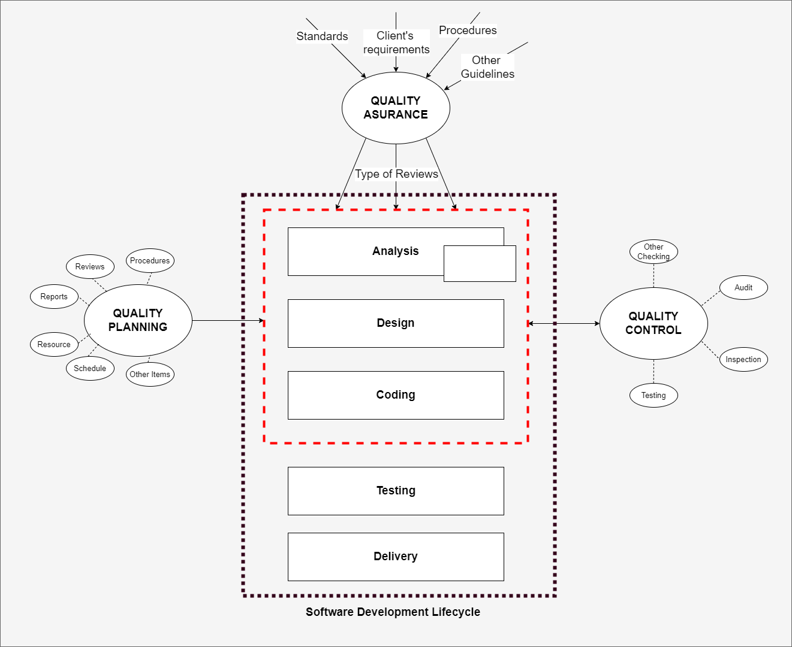
Quality management and software development
It is a management process that aims to develop and manage the quality of software during software development. - a technique to ensure that the product meets the quality standards and meet any necessary regulatory and developer requirements

Slide 17
Process and product quality
The quality of a developed product is influenced by the quality of the production process.
This is important in software development as some product quality attributes are hard to assess.
However, there is a very complex and poorly understood relationship between software processes and product quality.

Slide 18
Process-based quality
There is a straightforward link between process and product in manufactured goods.
More complex for software because:
  The application of individual skills and experience is particularly imporant in software development;
  External factors such as the novelty of an application or the need for an accelerated development schedule may impair product quality.
Care must be taken not to impose inappropriate process standards - these could reduce rather than improve the product quality.

Slide 19
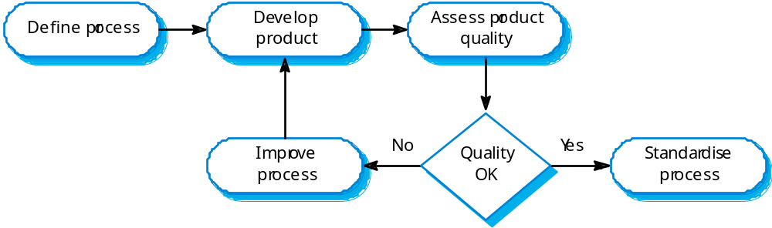
Process-based quality

Slide 20
Quality assurance and standards
Standards are the key to effective quality management.
They may be international, national, organizational or project standards.
Product standards define characteristics that all components should exhibit e.g. a common programming style.
Process standards define how the software process should be enacted.

Slide 21
Question and Answer Session
Q & A

Slide 22
Next Session
Software Quality Activities and Techniques

